Slide 1
Ljubljana/RINSC Fluence Cross Calibration
Andrew Kent

Slide 2
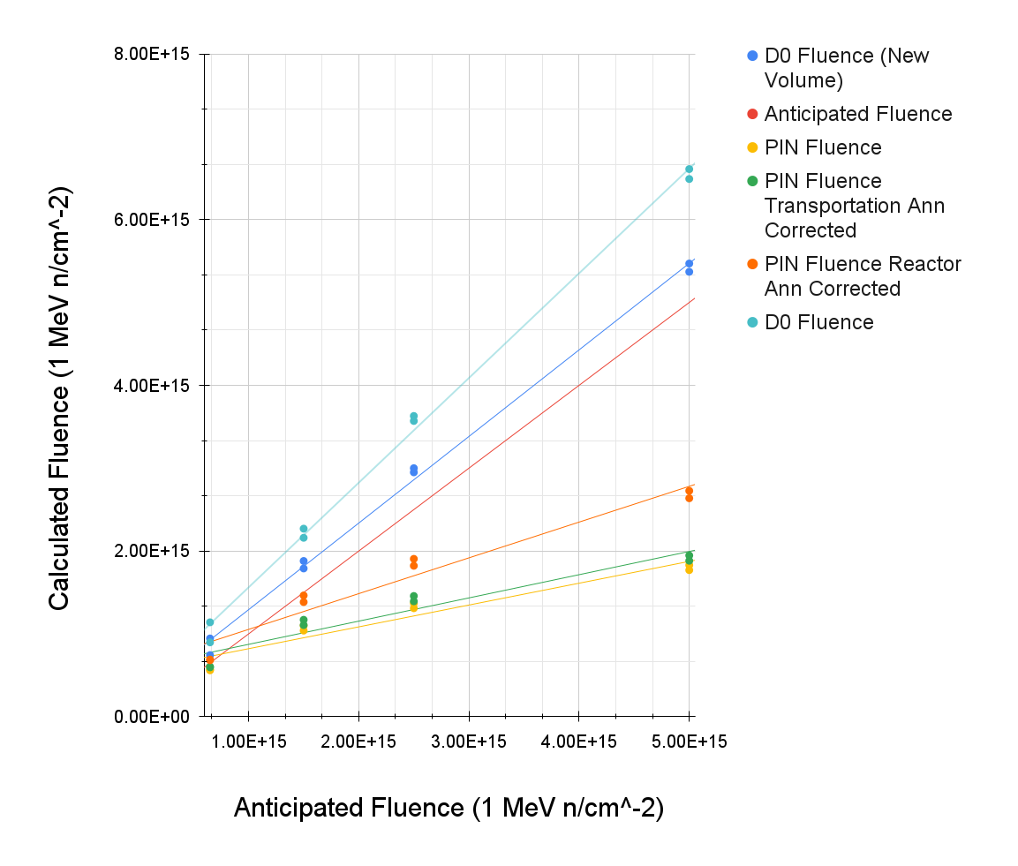
Anticipated Fluence vs. Calculated fluence for PIN and D0 diodes
D0 Diodes fluence estimates run higher than the predicted fluence though they seem to follow a linear trend
D0’s in the 1.5e15, 2.5e15 and 5e15 fluence batches did not deplete before our highest voltage (1100V), depletion voltages were therefore taken at the highest voltage as a “lower bound”
Pin fluence estimates run lower than anticipated values, though corrections due to transportation annealing (green) and reactor annealing (orange) bring it closer to anticipated
Saturation of pin fluence estimates still occurs as it did for RINSC irradiation runs

Slide 3
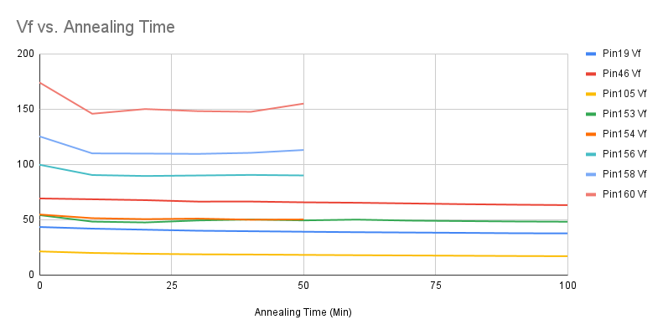
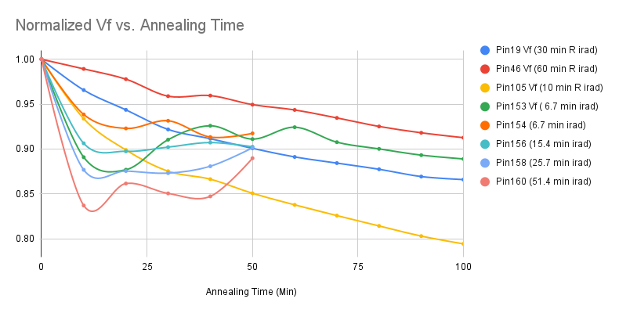
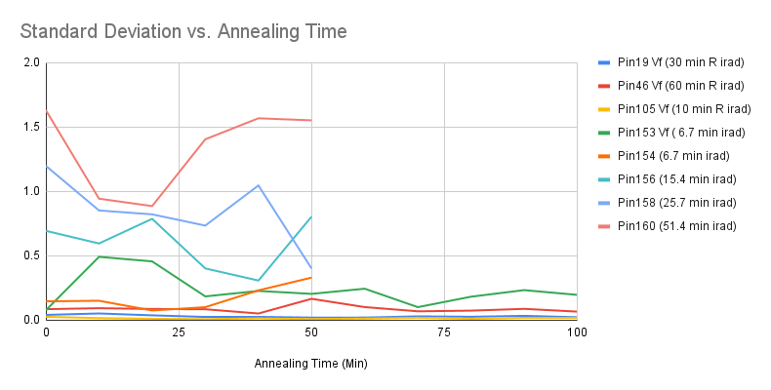
Ljubljana Pin Diode Annealing at 60C
Pin diode from Ljubljana (Pin 153) annealed at 60C for a total of 200 minutes, results normalized and plotted with pin diodes irradiated at RINSC and annealed via the same process
Pin Forward voltage of the pin diodes were measured at 1mA 30 times

Slide 4
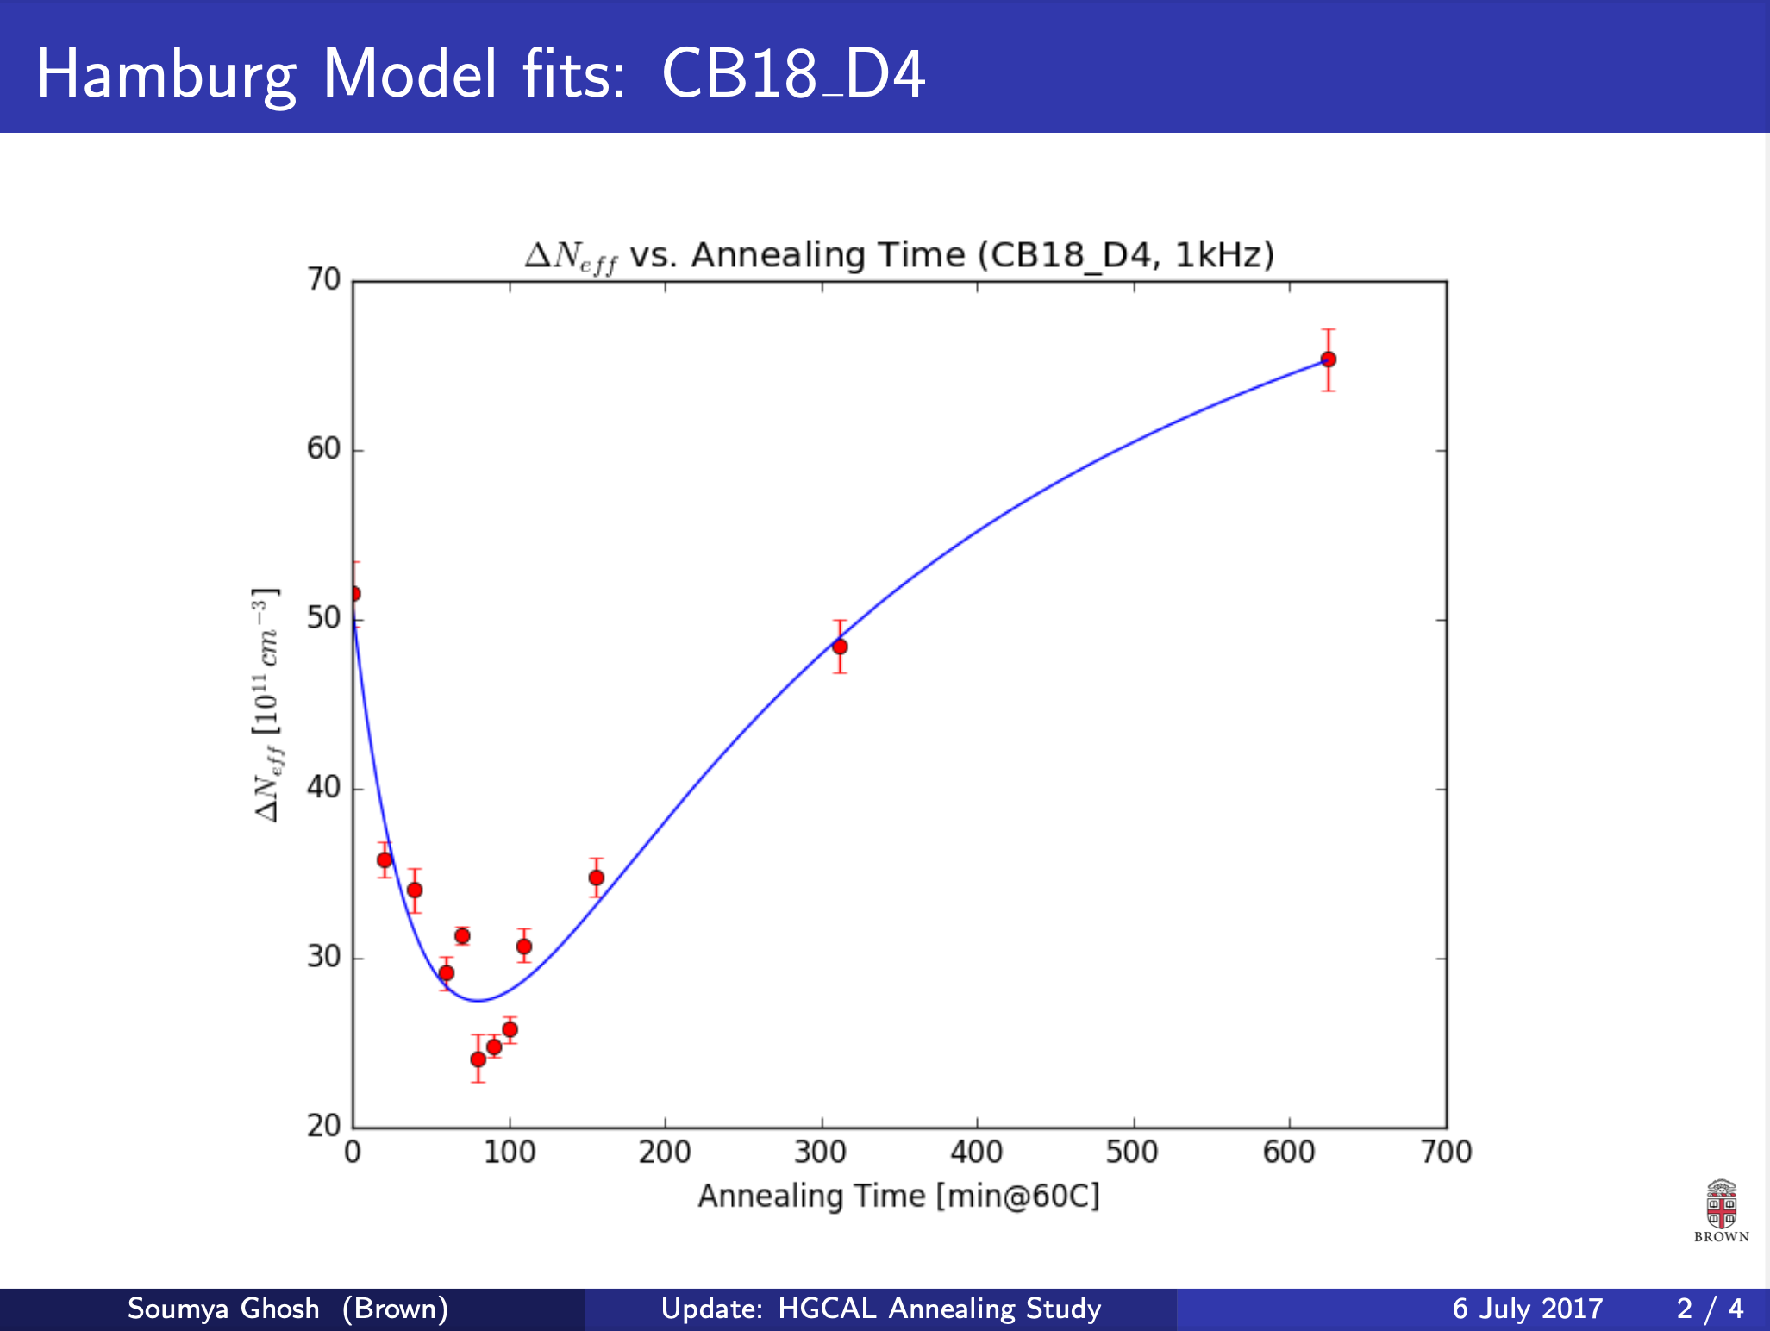
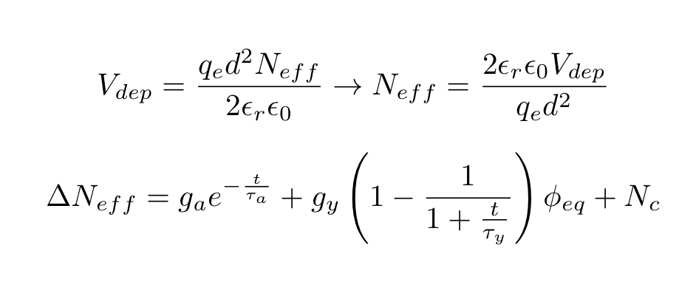
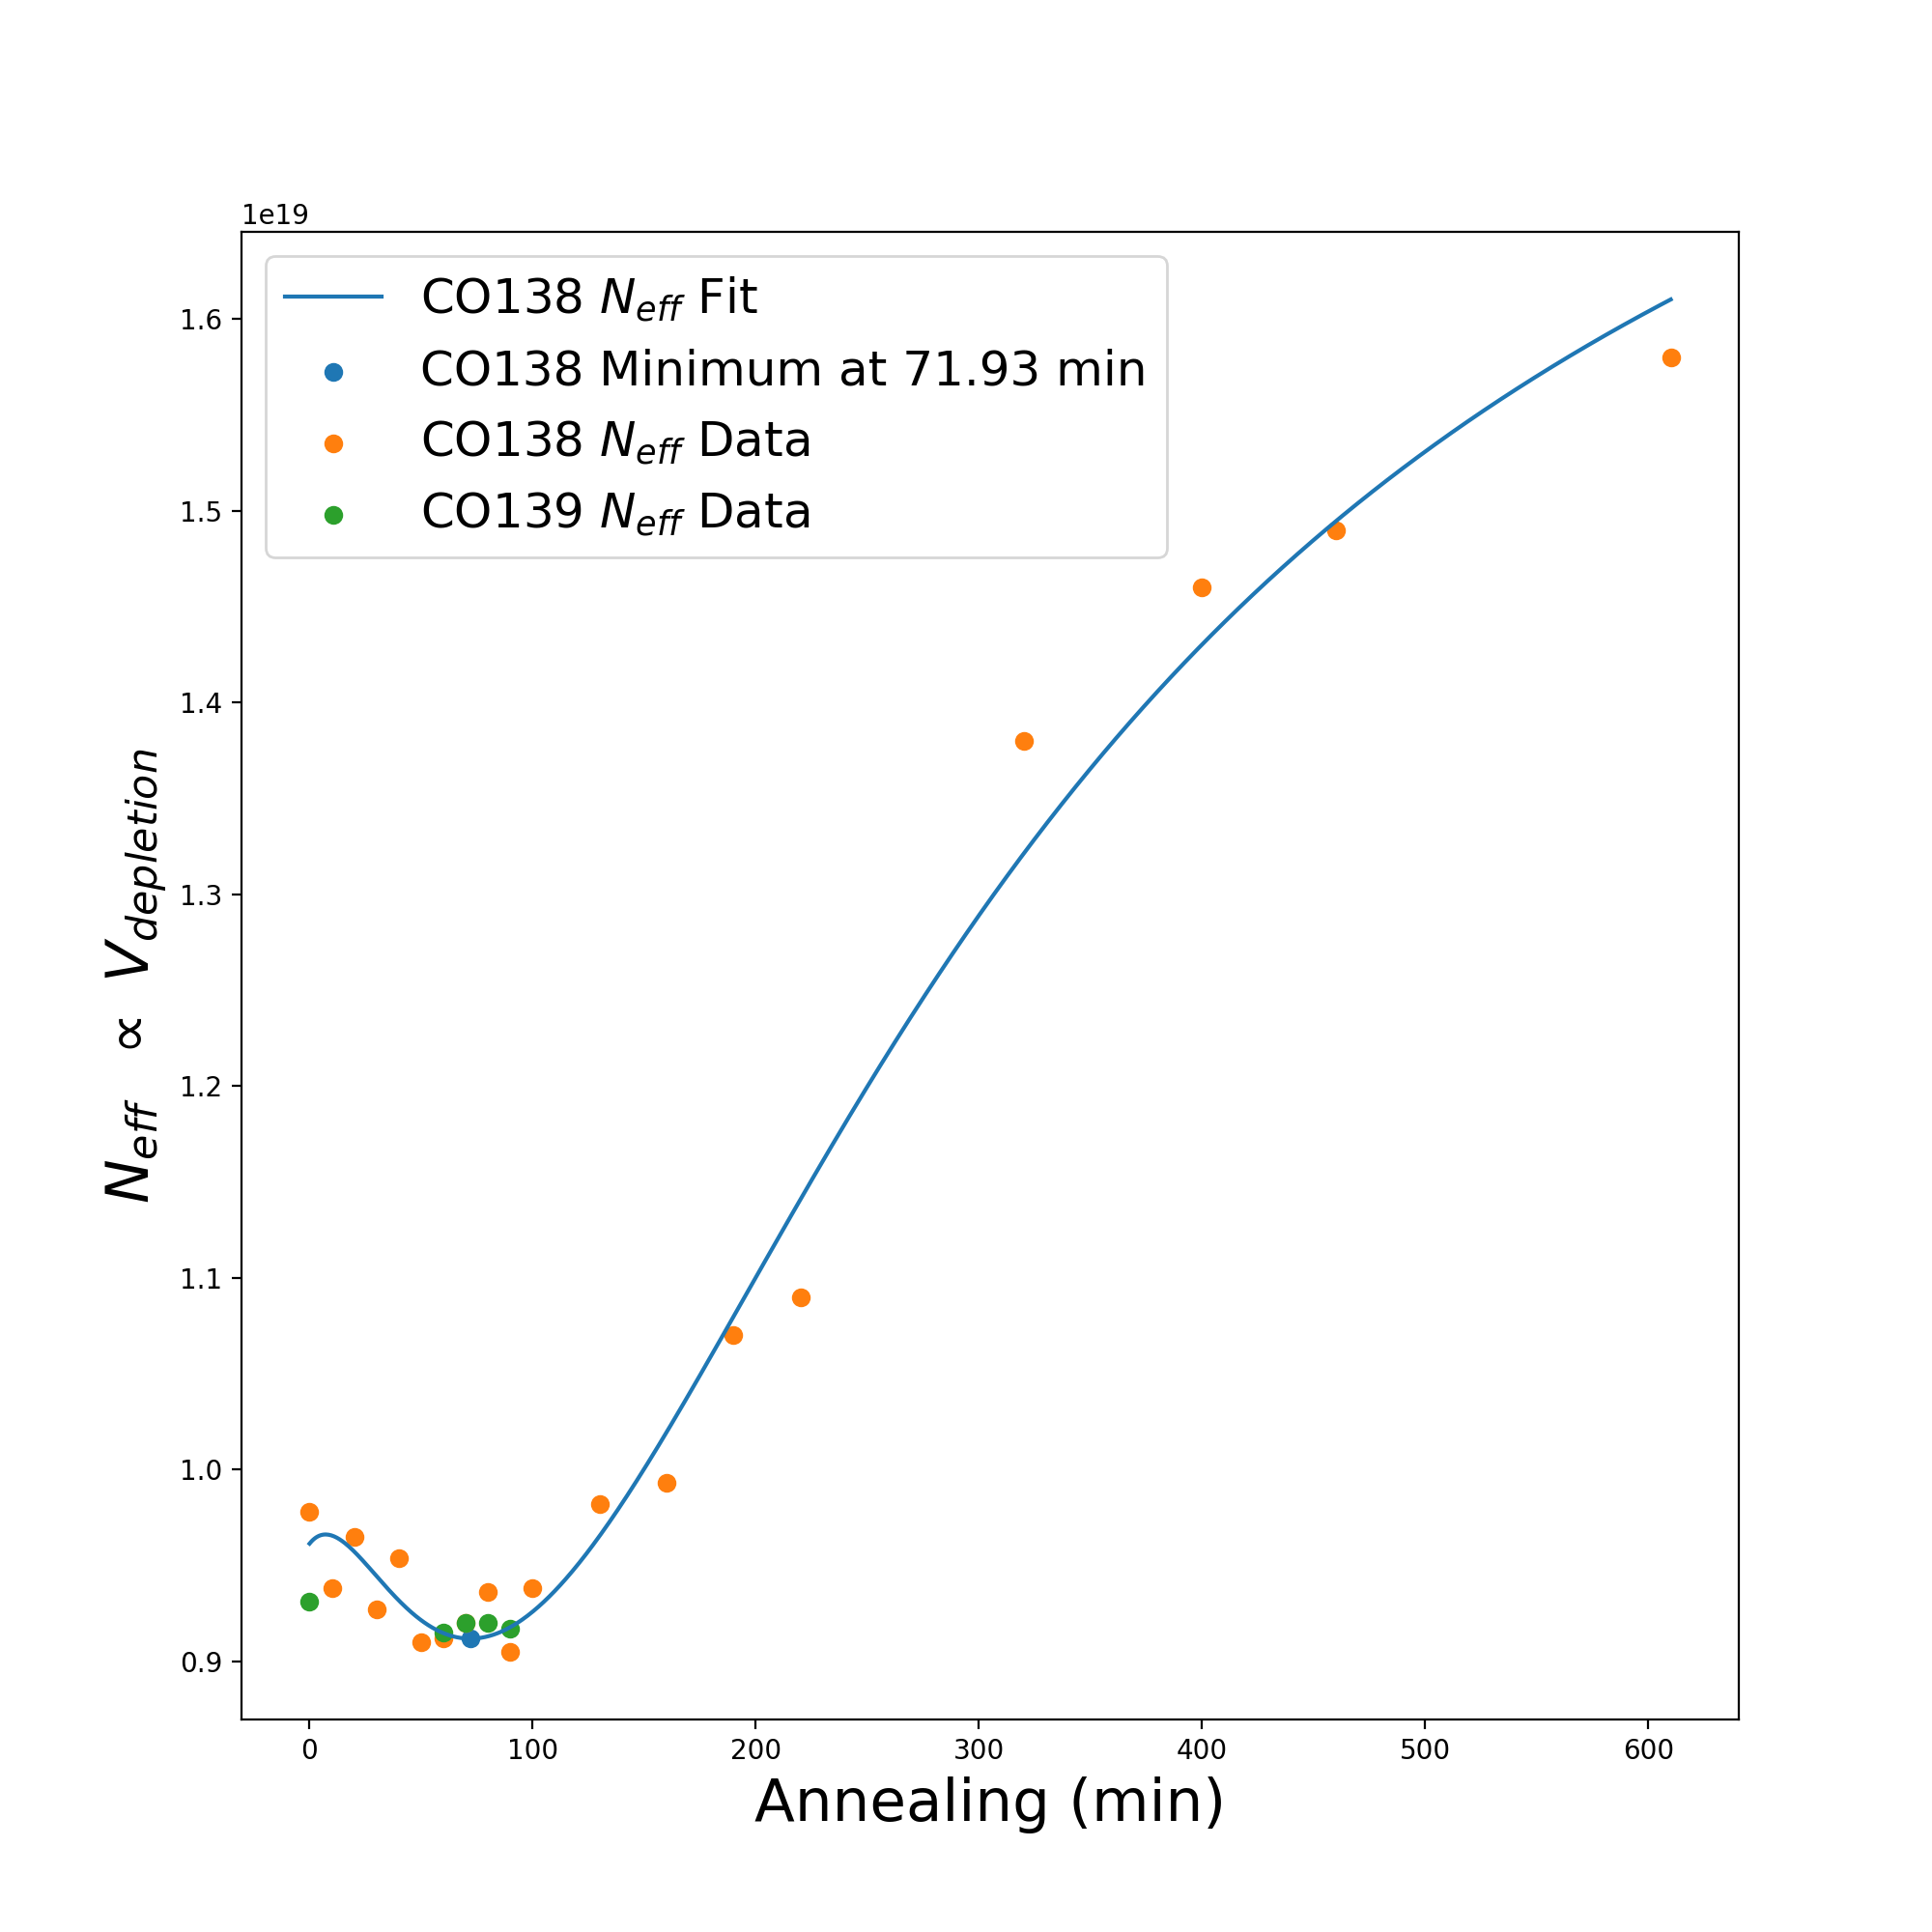
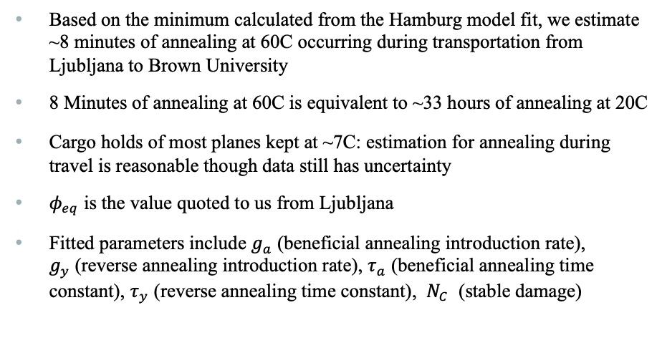
D0 Hamburg Model Fit
Based on the minimum calculated from the Hamburg model fit, we estimate ~8 minutes of annealing at 60C occurring during transportation from Ljubljana to Brown University
8 Minutes of annealing at 60C is equivalent to ~33 hours of annealing at 20C
Cargo holds of most planes kept at ~7C: estimation for annealing during travel is reasonable though data still has uncertainty
$φ_{eq}$ is the value quoted to us from Ljubljana
Fitted parameters include $g_{a}$ (beneficial annealing introduction rate), $g_{y}$(reverse annealing introduction rate), $τ_{a}$ (beneficial annealing time constant), $τ_{y}$ (reverse annealing time constant), $N_{C}$ (stable damage)

Slide 5
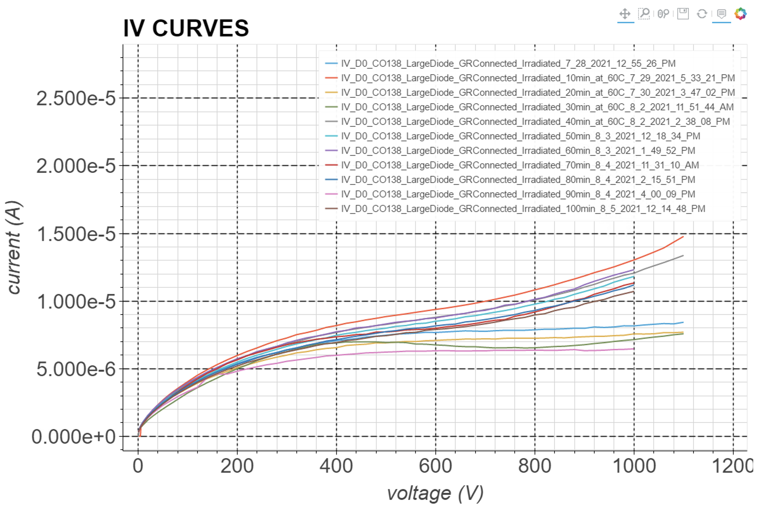
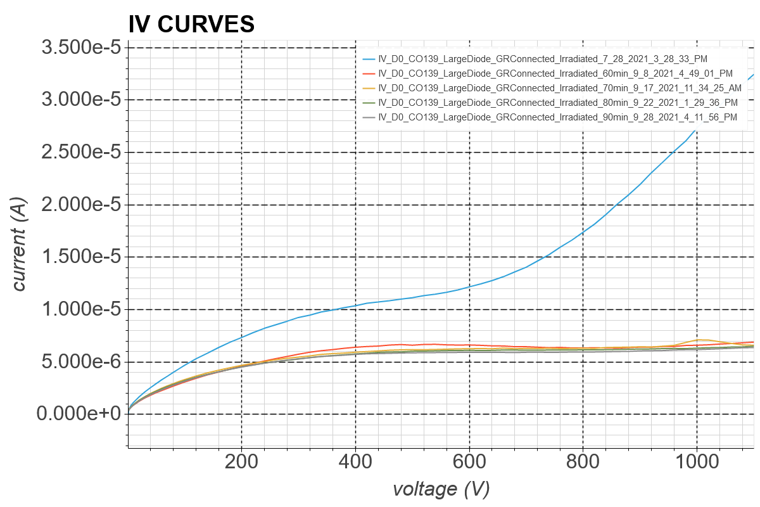
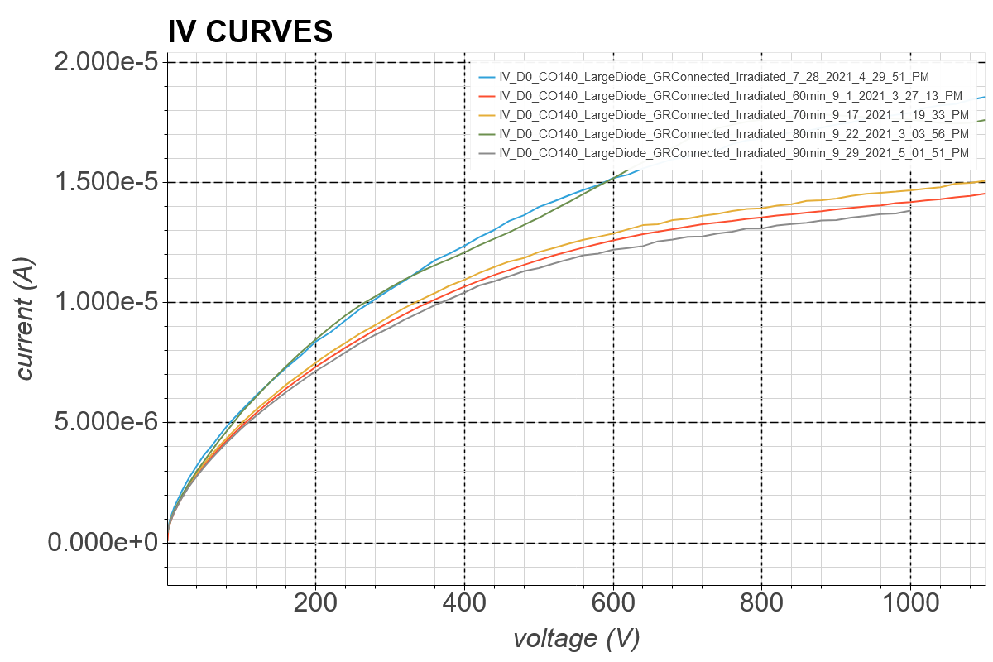
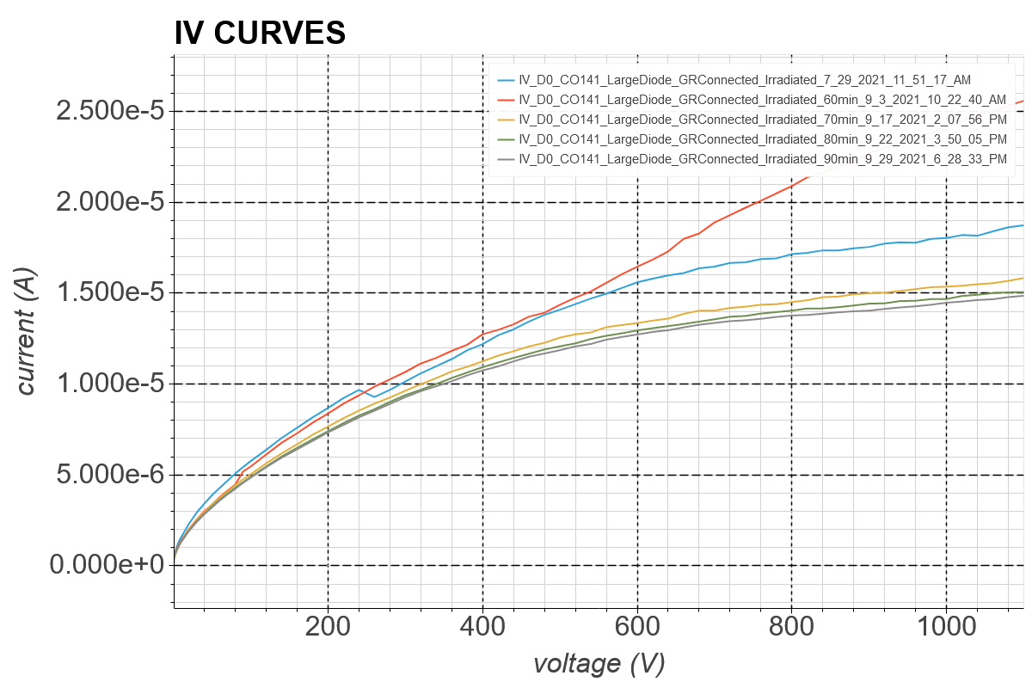
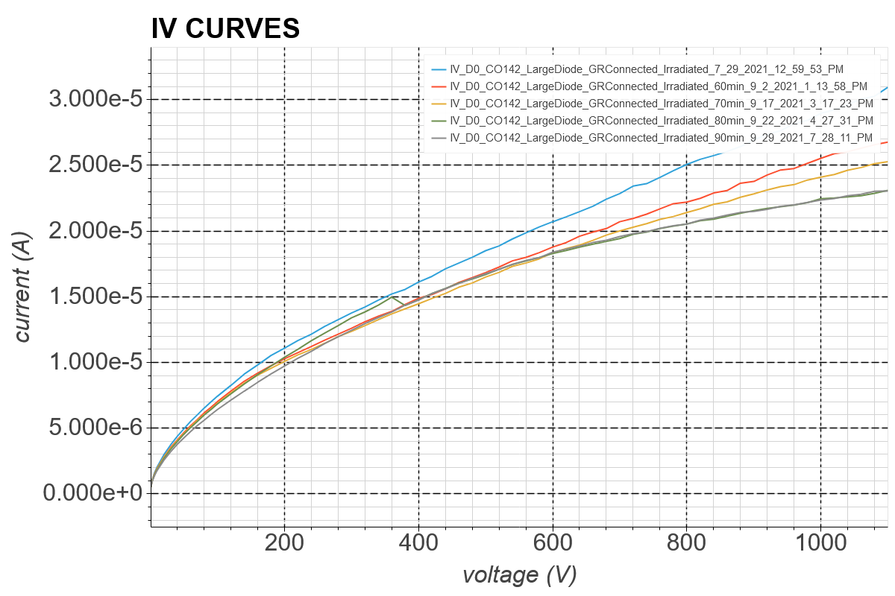
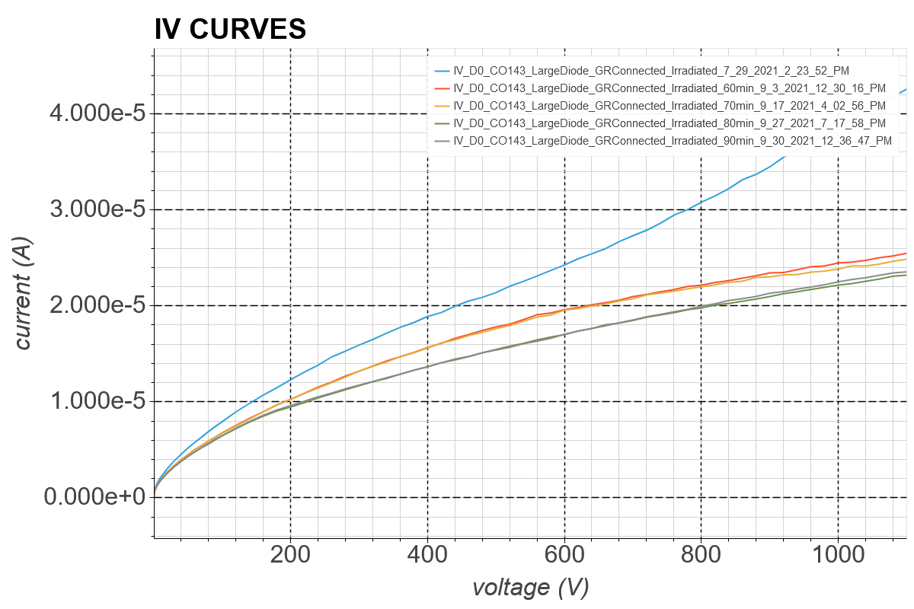
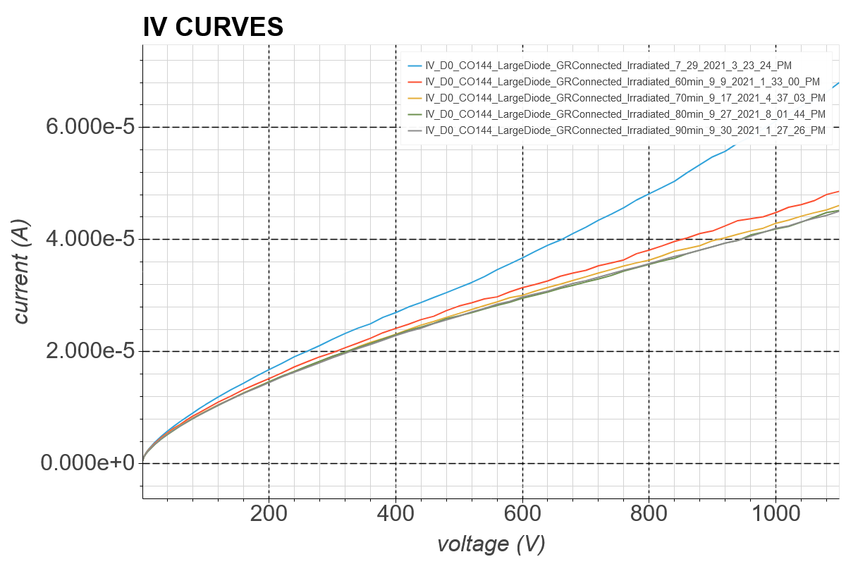
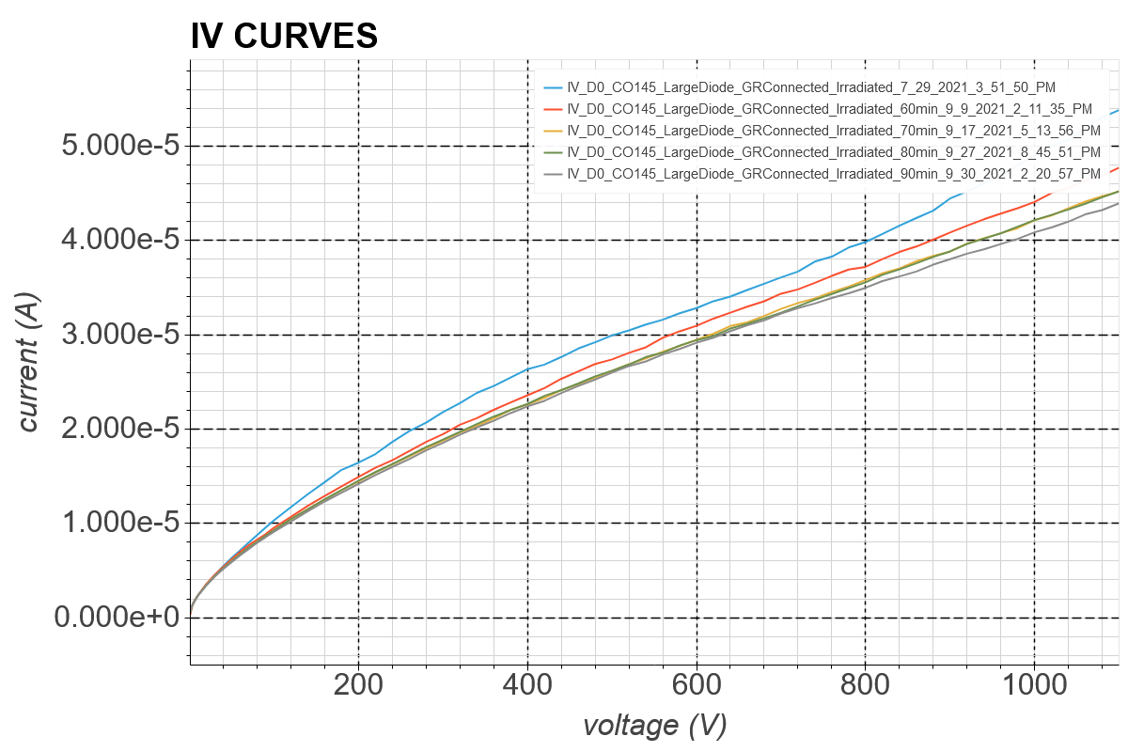
Ljubljana D0 IV Curves
CO138
CO139
CO140
CO141
CO142
CO143
CO144
CO145

Slide 6
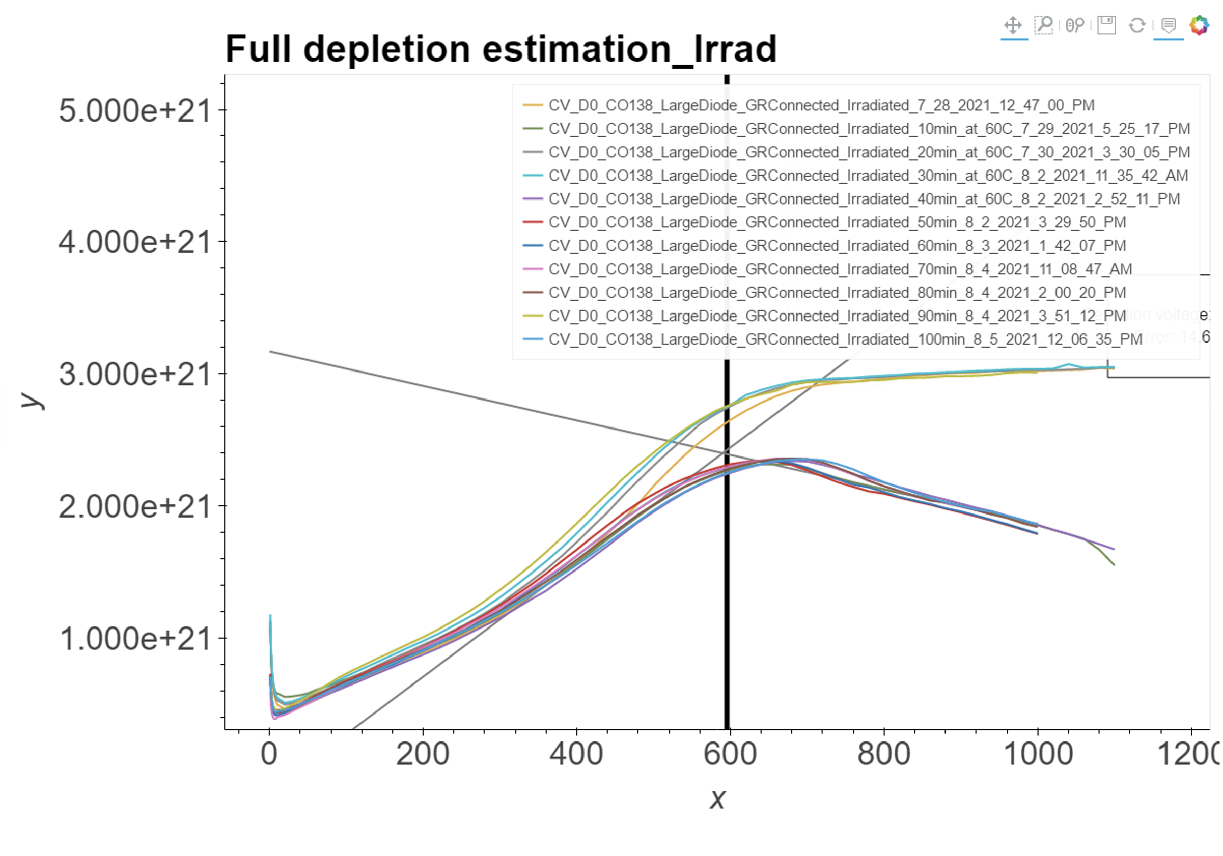
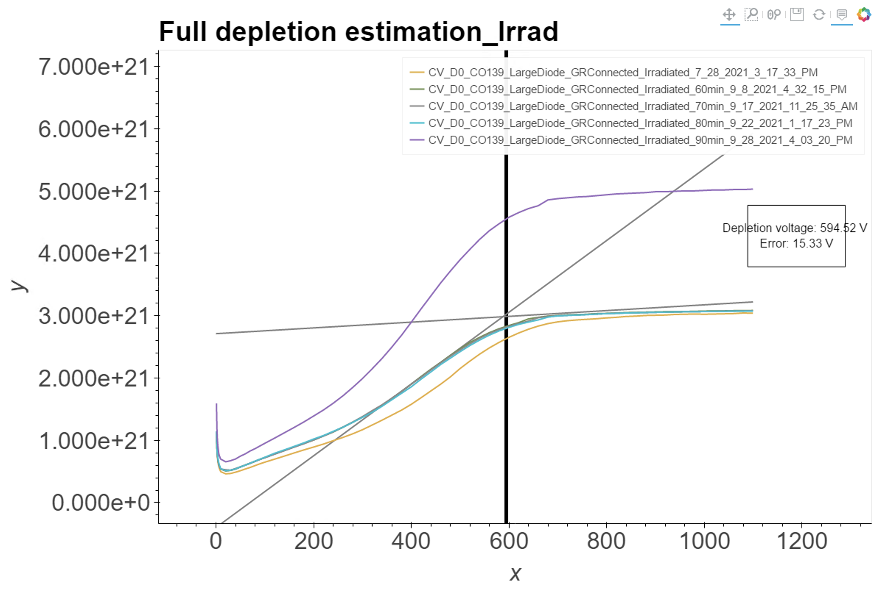
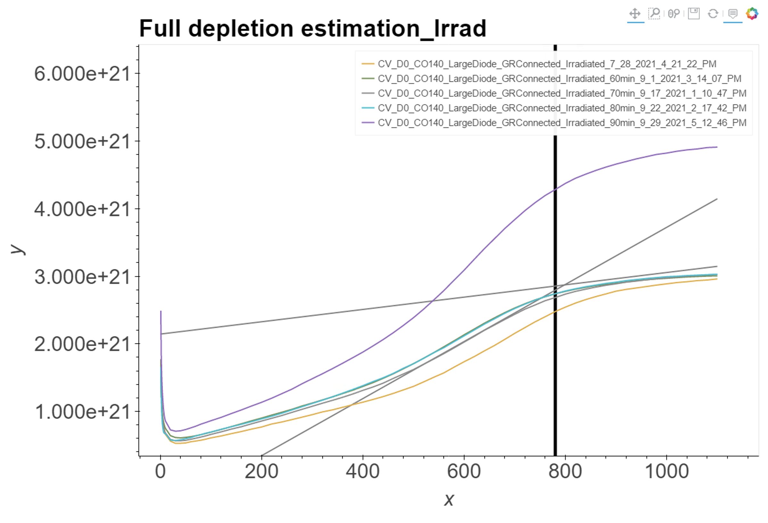
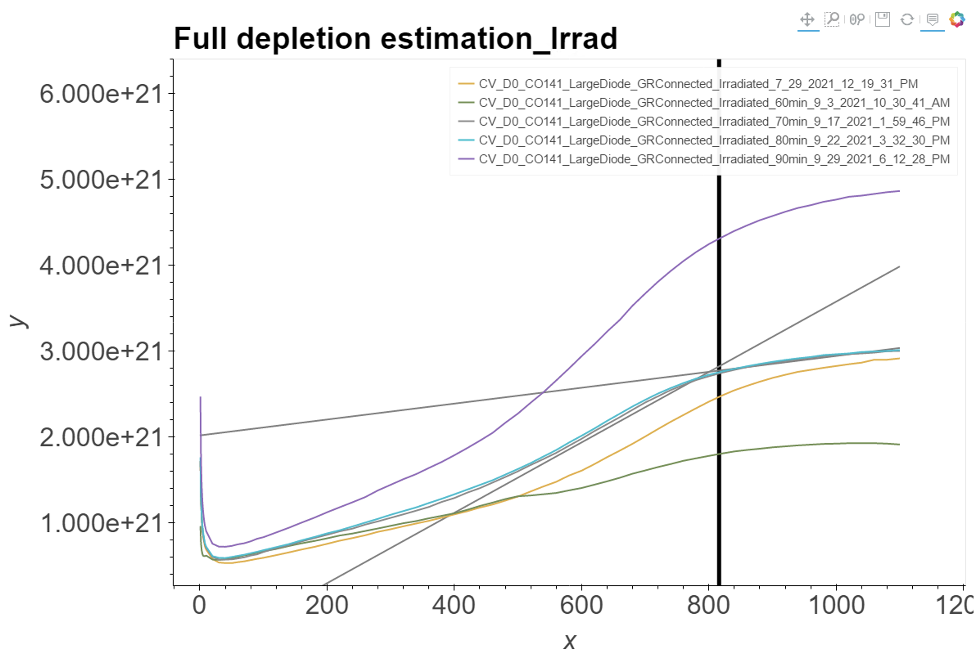
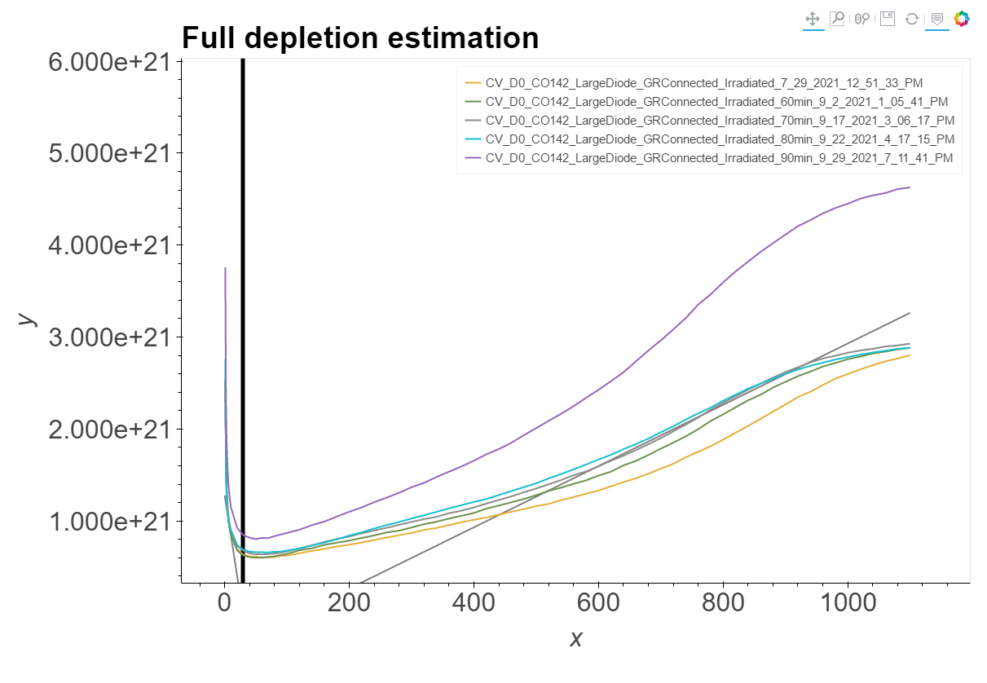
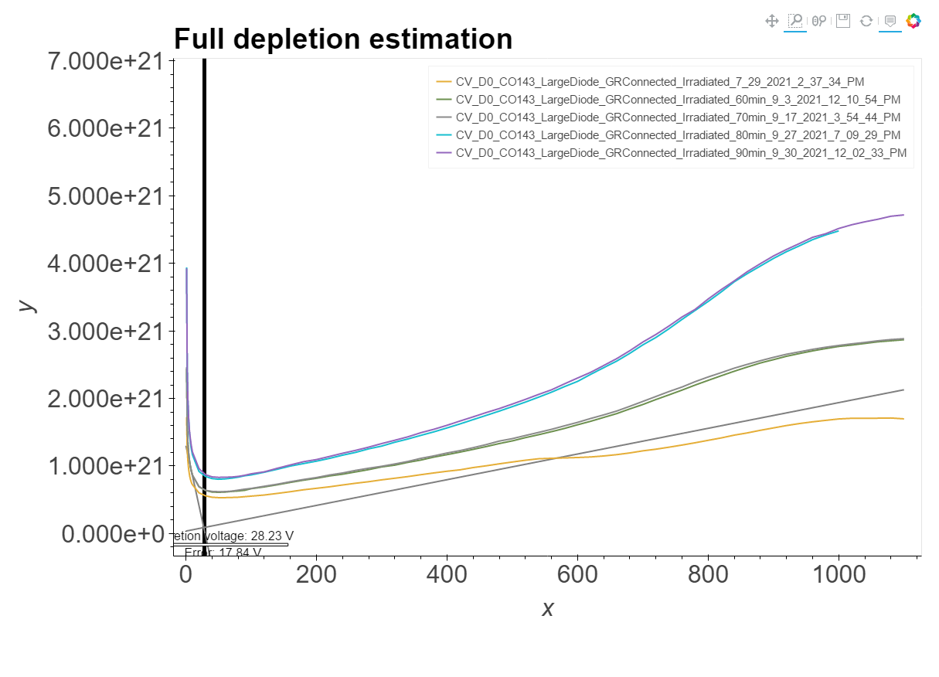
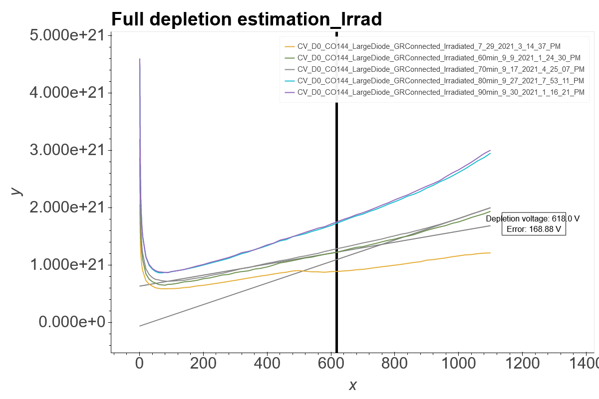
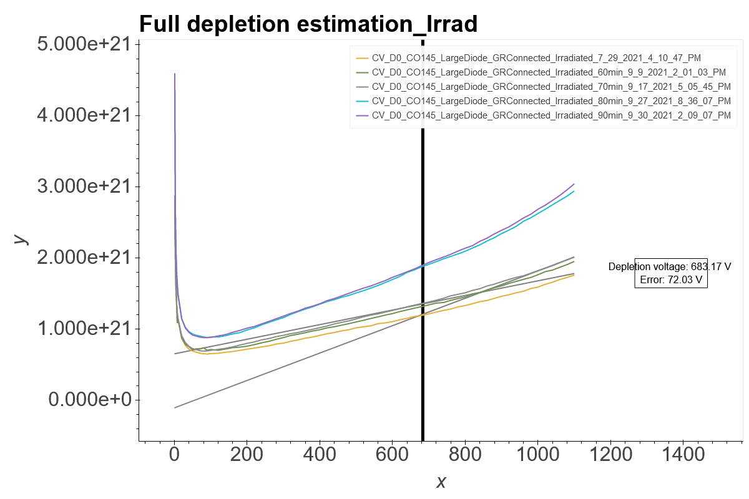

Ljubljana D0 $\frac{1}{C^{2}} vs V$ Curves
CO138 6.5E14
CO139 6.5E14
CO140 1.5E15
CO141 1.5E15
CO142 2.5E15
CO143 2.5E15
CO144 5E15
CO145 5E15

